Slide 1
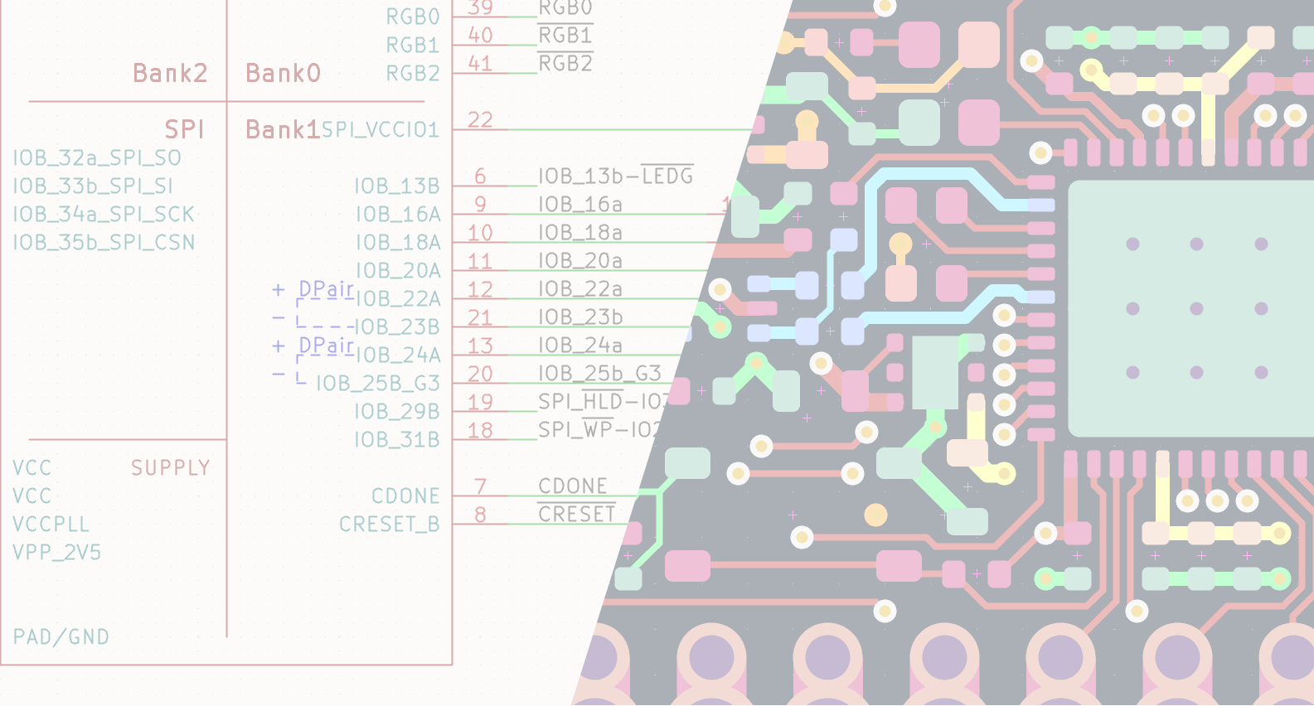

ECAD / MCAD collaboration with IDX
FABIEN CORONA | FOSDEM 2026 | 01/02/2026
Notes:
0:30

Slide 2

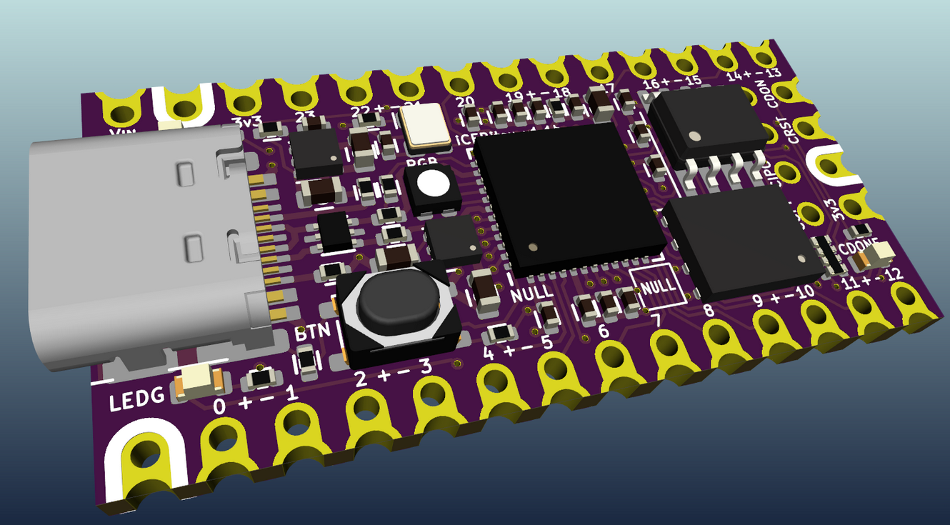
Introduction
ECAD : Electronic Computer-Aided Design
MCAD : Mechanical Computer-Aided Design
Topic : Collaborative design between ECAD and MCAD
Assumption : ECAD and MCAD are not a single package
In this presentation:
Ways of doing ECAD / MCAD collaboration
What is IDX :
  Its features
  How it works
KiCad proof of concept
Notes:
1:45

Slide 3
ECAD / MCAD
Notes:
1:50

Slide 4

Intro to ECAD / MCAD
⚙️
PCB
design tool
Mechanical
design tool
Goals of ECAD / MCAD collaboration :
- Designing both mechanical parts and PCB together
- Taking MCAD constraints into account when designing the PCB ( and vice versa )
- Making sure the board fits the mechanical part ( enclosure, moving parts, etc... )
with the correct revision !
Notes:
3:15

Slide 5
Old-school collaboration
Example of an MCAD-driven design
👤 📜 ⚙️
ECAD user
2D drawing
( PDF, print, … )
This process is slow, the ECAD user needs to convert the information to the ECAD software
Prone to errors
Feedback from the ECAD user to the MCAD user is not easy
Notes:
4:50

Slide 6
Usual way of collaboration
Example of an MCAD-driven design
👤 ⚙️
🗎
ECAD user
ECAD
compatible file
Process is simple
Errors are limited
Feedback from the ECAD user to the MCAD user is not easy
ECAD → MCAD : step, idf
MCAD → ECAD : dxf, svg, idf
Notes:
6:00

Slide 7
Synchronized collaboration
👤
⚙️
👤
Process is simple
Errors are limited
ECAD and MCAD softwares use the same file format: Feedback is easy
Notes:
6:45

Slide 8
What is IDX ?
Notes:
6:50

Slide 9
What is IDX ?
IDX = Incremental Design eXchange
Specifications : www.ecad-mcad.org
IDX key features:
    Board outline, rule areas, components
    Incremental changes, accept / reject changes, history, comments on changes
    Add / remove / replace objects
    Object ownership
    Synchronous or asynchronous
IDX is adapted if:
    There are several iterations
    Multiple ECAD / MCAD users (not fully implemented)
Notes:
8:30

Slide 10
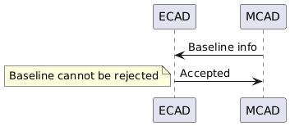
Defining a baseline
Baseline : first exchange, base for incremental changes
@startuml
participant ECAD
participant MCAD
MCAD -> ECAD : Baseline info
ECAD -> MCAD : Accepted
note left
Baseline cannot be rejected
end note
@enduml
Information usually include:
      Board outline
      Collaboration information (author, date, software, …)
      Constraints ( limited height zone, no component zone, ... )
This can be initiated from both ECAD and MCAD
Notes:
9:35

Slide 11
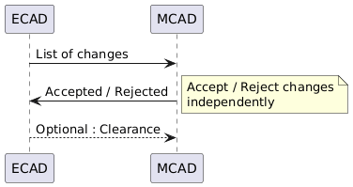
Incremental changes
@startuml
participant ECAD
participant MCAD
ECAD -> MCAD : List of changes
MCAD -> ECAD : Accepted / Rejected
note right
Accept / Reject changes independently
end note
ECAD --> MCAD: Optional : Clearance
@enduml
A change can be:
      Moving an element
      Adding / Removing an element
      Replacing an element
This can be initiated from both ECAD and MCAD
Notes:
10:27

Slide 12
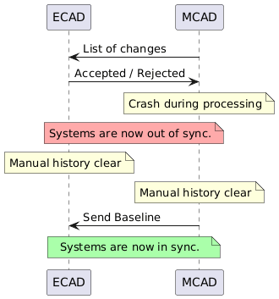
Re-baselining
Re-baselining : action of resetting the collaboration
@startuml
participant ECAD
participant MCAD
MCAD -> ECAD : List of changes
ECAD -> MCAD : Accepted / Rejected
note over MCAD: Crash during processing
note over ECAD, MCAD #FFAAAA: Systems are now out of sync.
note over ECAD: Manual history clear
note over MCAD: Manual history clear
MCAD -> ECAD : Send Baseline
note over ECAD, MCAD #AAFFAA: Systems are now in sync.
@enduml
Should only be used if the collaboration is out of sync.
Notes:
11:20

Slide 13
In practice: IDX files
Notes:
11:25

Slide 14
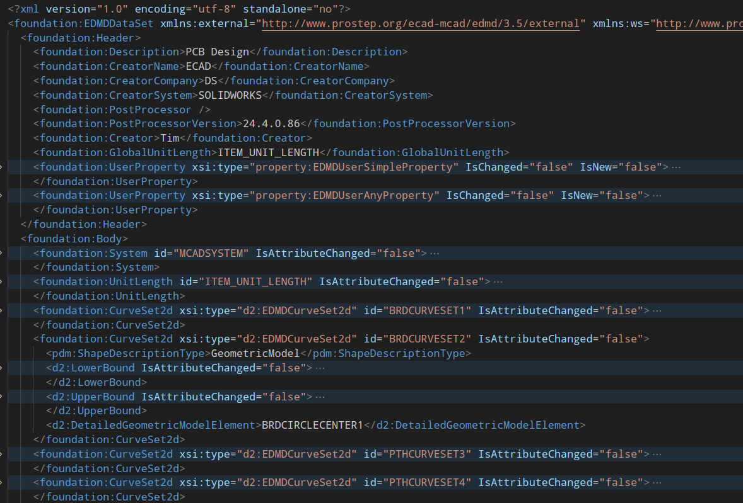
Baseline idx file
Header with:
Info about participants
Info about softwares
Default length unit
Body with:
Info about items
Notes:
12:22

Slide 15
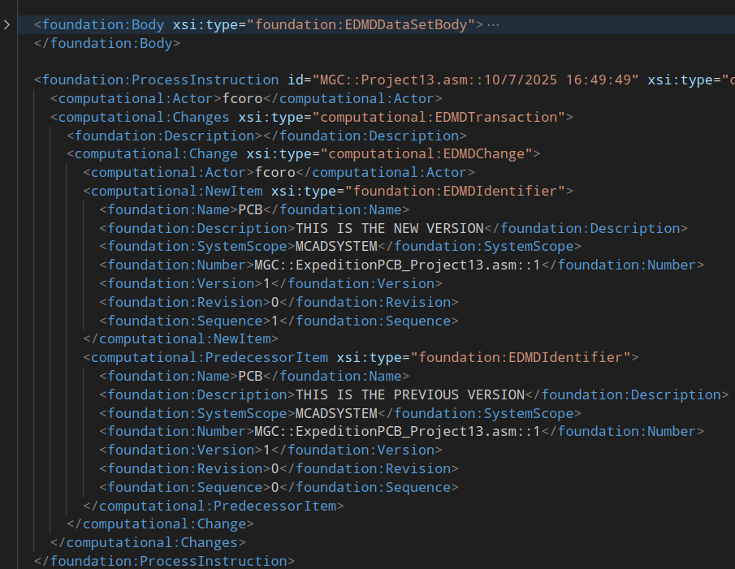
Change idx file
Process instructions with:
Reference to the previous and the new versions.
Both versions can be found in the body.
(Here, a board cutout change)
Notes:
13:10

Slide 16
Sharing the IDX files
Direct communication:
IDX is mostly implemented by closed source softwares.
There is no public IDX library, therefore there are many implementations.
A server should be implemented as ECAD and MCAD softwares may not be online.
Network shared folder:
This is usually the method used.
The ECAD / MCAD software write the file in the shared folder
Emailing / message the files:
Not efficient and prone to errors
Notes:
14:30

Slide 17
Example with a shared folder
👤
1. ECAD user triggers sync
2. ECAD software writes a change IDX file
3. MCAD software detects IDX file*
📁
8. ECAD notifies user
4. MCAD notifies user
7. ECAD software detects IDX file*
⚙️
6. MCAD software writes a response IDX file
👤
5. MCAD user accept / rejet changes
*detections can be replaced with user messaging each other and loading the files
Notes:
16:05

Slide 18
Status in KiCad
Notes:
16:15

Slide 19
Current status
An MR for IDX support is open :
https://gitlab.com/kicad/code/kicad/-/merge_requests/2341
Maybe in KiCad v11 (2027) ?
The current MR focuses on receiving information from MCAD.
It is has been tested with Siemens Solid Edge
Notes:
17:00

Slide 20
Supported features
 | ECAD → MCAD | MCAD → ECAD
Generating baseline | ❌
Receiving baseline |  | ✅
Generating changes | ❌
Receiving changes |  | ✅
Generating change reponses |  | ✅
Receiving change reponses | ❌
Diff viewer | 🚧 | 🚧
Repository handling | 🚧 | 🚧
Notes:
17:45

Slide 21
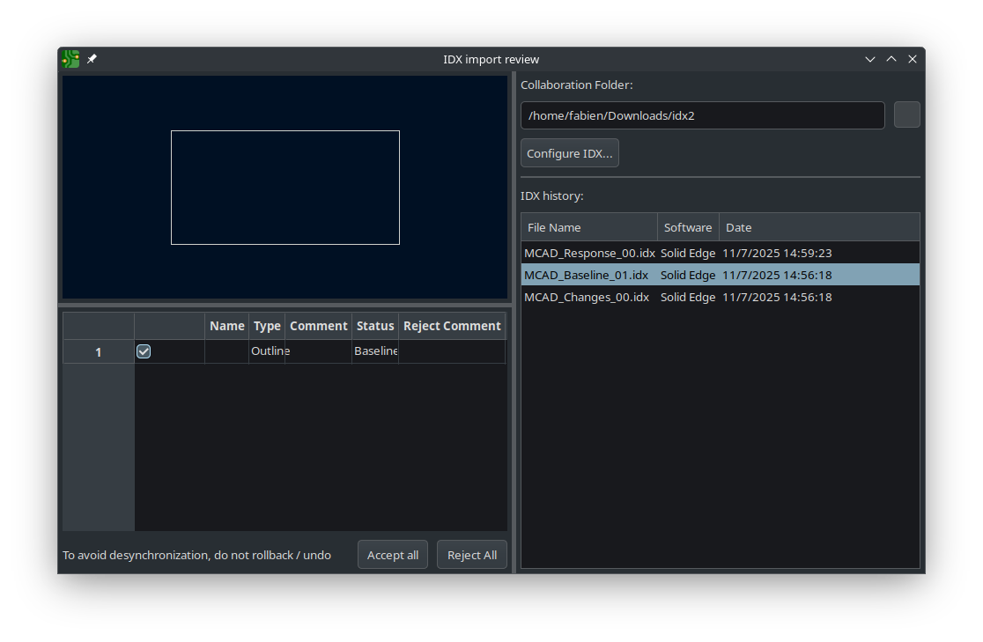
Prototype interface
Notes:
19:00

Slide 22
IDX with extra steps
Notes:
19:10

Slide 23
Enabling 1:n collaboration
Example: a board integrates into several devices
⚙️
👤
👤
📁
⚙️
👤
⚙️
👤
⚙️
👤
⚙️
👤
Notes:
19:55

Slide 24

Sharing libraries
How adding a component in ECAD will lead to the correct 3D model in MCAD ?
Can an MCAD designer add an electronics component ?
ECAD libs
MCAD libs
📁
⚙️
Product data management (PDM) system
Component reference | Name in ECAD library | Name in MCAD library
Notes:
21:10

Slide 25



Enabling alternative worflows
In some companies, using KiCad instead of a closed source ECAD software can prove difficult:
There is a complex ecosystem. IDX is sometimes part of that ecosystem
📁
⚙️
Product data management system
Product lifecycle management system
Notes:
23:10

Slide 26
Enabling IDX for FOSS
The IDX feature is being developped within KiCad for simplicity.
It has been coded so it can be extracted if needed, so other FOSS CAD tools can use it
⚙️
IDX
IDX

Slide 27
Conclusion
Notes:
25:00

Slide 28
Conclusion
IDX allows for synchronization between ECAD and MCAD
Incremental changes allows for discussing and tracking changes
It does not replace designers talking to each other
KiCad proof of concept in development
Looking forward to sharing implementation with MCAD software for testing
Notes:
25:00

Slide 29
Thank you

